Slide 1
Re-Imagining Youth Confirmation:
Themes, Practices, & Particularities
Lisa Kimball Terri Martinson Elton
Virginia Theological Seminary Luther Seminary
Notes:
Introduce ourselves – conversion
Why interested!

Slide 2
Research Question
What is the state of confirmation and equivalent practices within five denominations that practice infant baptism?

Slide 3
Research Design
Mixed Methods:
Quantitative: Survey
Population Sample
Email, Online
Qualitative: Portraiture
Site visits: 20 congregations and 5 camps
Notes:
The Quantitative Surveys are in a second round of collecting data, so this work will focus on the qualitative work
Say something about Portraiture as a methodology.

Slide 4
Themes
Resilient
Contextual and owned by congregation
Adaptive and responsive
Committed leadership and resources
High parental investment
Bridge, not graduation

Slide 5
Practices
Building on congregation’s strengths
Tending relationships
Mentoring
Exploring beliefs
Making public affirmation of faith

Slide 6
Three Hopeful Shifts
Purpose
Pedagogy
Context
Notes:
Together, these themes and practices are suggesting significant shifts in the PURPOSE, PEDAGOGY & CONTEXT of confirmation. These shifts are not independent of one another. Rather they are interrelated.
We will talk about the specifics of each, but know the others always “in the conversation” as well.

Slide 7
Purpose
Engagement first, doctrine second.
Shift from focus on rite to focus on youth engagement
Adaptive practice meeting spiritual hunger
Notes:
While most of these denominations have a rich history of confirmation ministry – and confirmation is often in the DNA of the congregation – confirmation ministry (in the congregations in the qualitative side) is viewed as an opportunity for connecting with young people, nurturing faith and deepening discipleship. Unique opportunity – and different than youth ministry “in general”
Connected to that is – Congregation’s don’t assume everyone knows what confirmation is –so they state the purpose (within tradition and within their community) and outline what they do and why.
In this way they see beyond – beyond confirmation rite/service, beyond high school ministry, beyond church membership – and aim for making faith meaningful for young people – personally and communally in their context..
So – for these congregations, the purpose of confirmation was not simply learning church doctrine and/or participating in a rite but connecting to spiritual questions of young people and nurturing their journey of faith.
Lisa – story of her denomination’s struggle.

Slide 8
Purpose
Lifelong followers of Jesus first, Christian community second.
Shift from focus on equipping for church membership and denominational loyalty to lifelong journeys as followers of Jesus
Personal faith as part of a larger tradition and connected to Christian community

Slide 9
Purpose
Confirmation as an intensive, focused time of learning the practices and beliefs of the Christian faith.
Question - How is confirmation meeting the spiritual hungers of youth AND teaching the beliefs and practices of the church?
Notes:
Sturderier faith
Expectation matters -

Slide 10
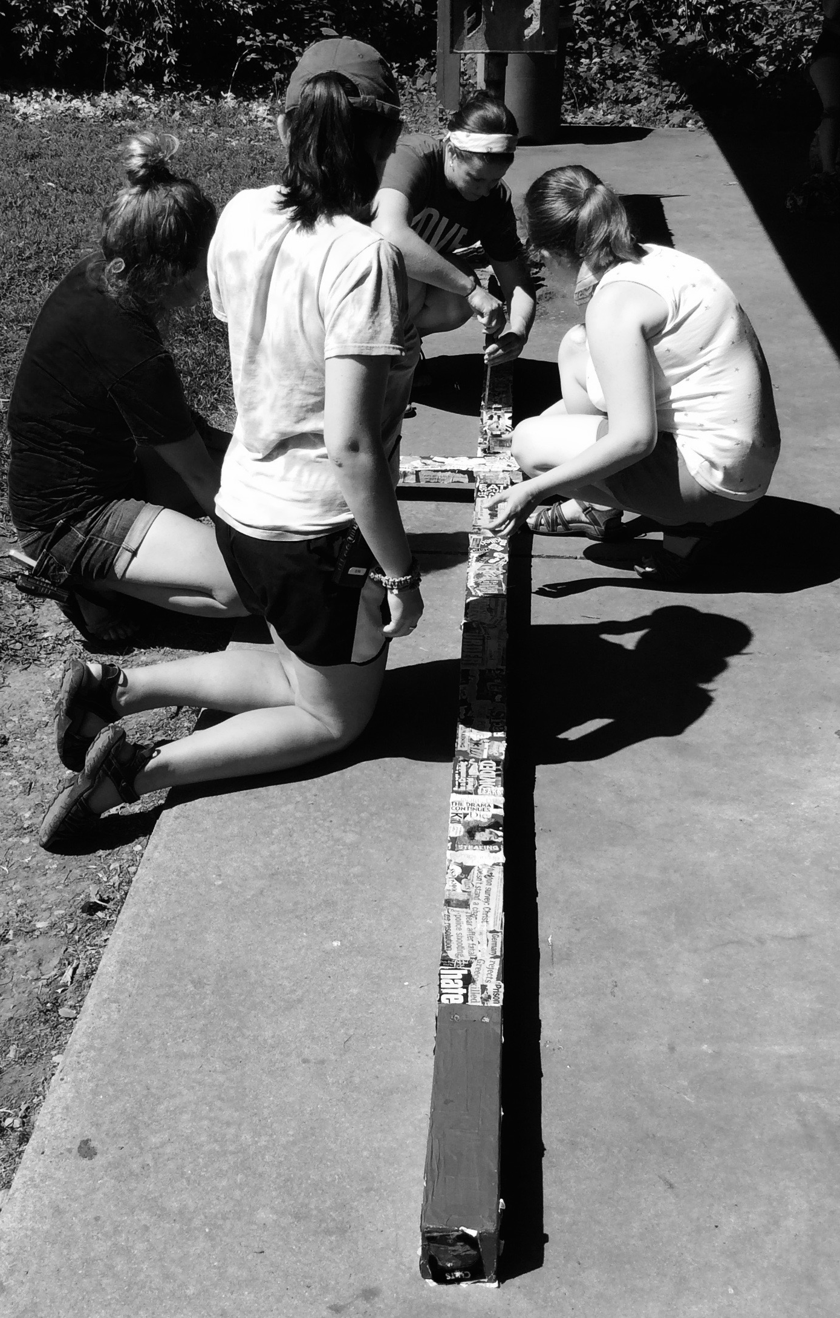
Pedagogy
Freedom & Accountability
Shift from traditional, didactic instruction to resource-rich learning environment
Draws on the agency of students, invites them into teaching and learning process
Notes:
- Relationally rich learning (Content in the midst of community.)
Honors questions and curiosity of young people – lets the world be an integral part of the curriculum.
Sees the agency of young people (in learning, caring, serving, worshipping, leading) Draws out the gifts of young people. Formally and informally.
Integrating multiple pedagogical strategies – intentionally designed (time separate, regular time, time away, time in the world, time with the congregation) parts and whole.
Intergeneration opportunities. – this points to the congregation deepening and widening their faith formation as well.
Expectations – of students, community, and God it be part of this transformative work.
Why? Wider cultural shifts in expectations about teaching and learning. Democratization of learning.

Slide 11
Pedagogy
Life-wide, relationally-rich
Shift from cognitive learning about Christianity to active engagement with it
Intentionally designed to connect personal life, faith, and world
Notes:
- Integrating multiple pedagogical strategies – intentionally designed (time separate, regular time, time away, time in the world, time with the congregation) parts and whole.
Intergeneration opportunities. – this points to the congregation deepening and widening their faith formation as well.
Expectations – of students, community, and God it be part of this transformative work.
Why? Wider cultural shifts in expectations about teaching and learning. Democratization of learning.

Slide 12
Pedagogy
Confirmation as transformational learning and vocational discernment
Question - In what ways is confirmation ministry drawing youth into a vibrant learning community?
Notes:
Multi-faceted with many teachers addressing many learning styles
Address the whole person – life-wide piece

Slide 13
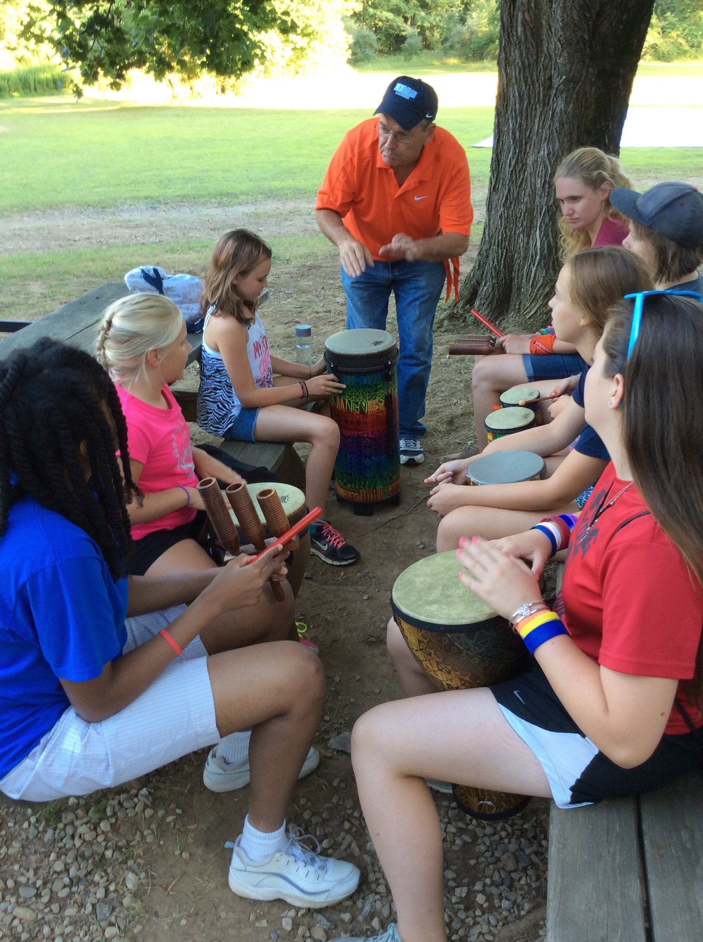
Context
Local & Organic
Shift from uniform practice to working with congregational and contextual assets and challenges
Ongoing discernment and attention to congregational and contextual needs
Notes:
CONTEXT – American religious landscape has changed forever. Post-denominational world. Confirmation in our 5 denominations must be relevant and local.
Confirmation is not “the pastor’s” job (one person), not a “have to” ministry. Connected to a deeper commitment to faith formation and lifelong discipleship, confirmation is ONE PIECE of a larger puzzle.
Healthiest congregations ministry reflect the character and dynamism of their context and community. It is not about size, but about relationships, wider ownership of ministry, and understanding of the shifting understanding of the role of church and everyday life.
Two stories:
Lisa - St, John’s
Terri – Trinity (problem and made it useful)

Slide 14
Context
Congregation-wide
Shift from separate ministry/event to process owned by congregations and connected to the wider church/community
Shared leadership and ownership of confirmation
Notes:
Confirmation is not “the pastor’s” job (one person), not a “have to” ministry. Connected to a deeper commitment to faith formation and lifelong discipleship, confirmation is ONE PIECE of a larger puzzle.
Healthiest congregations ministry reflect the character and dynamism of their context and community. It is not about size, but about relationships, wider ownership of ministry, and understanding of the shifting understanding of the role of church and everyday life.
Two stories:
Lisa - St, John’s
Terri – Trinity (problem and made it useful)

Slide 15
Context
Confirmation as adaptive and resilient faith formation ministry
Question - How is confirmation ministry taking into account the particularities of your setting?

Slide 16
Themes, Practices, & Particularities Three Shifts
Purpose
Pedagogy
Context

Slide 17
Lived Tensions
Accommodation – “Orthodox” doctrine
Gospel as status quo – Gospel as disruption
Quick and easy – Slower and deeper
Need mentors – Spiritual maturity of mentors
Focus on confirmation – What’s next?

Slide 18
Re-imagining Confirmation
It matters
It takes a team
Builds intergenerational learning community
Claiming the Way of Jesus
Practitioners need to talk with each other

Slide 19
www.theconfirmationproject.com

